Slide 1
SPM points
19/06/2024
Simone Ferrari (simone.ferrari@polito.it)

Slide 2
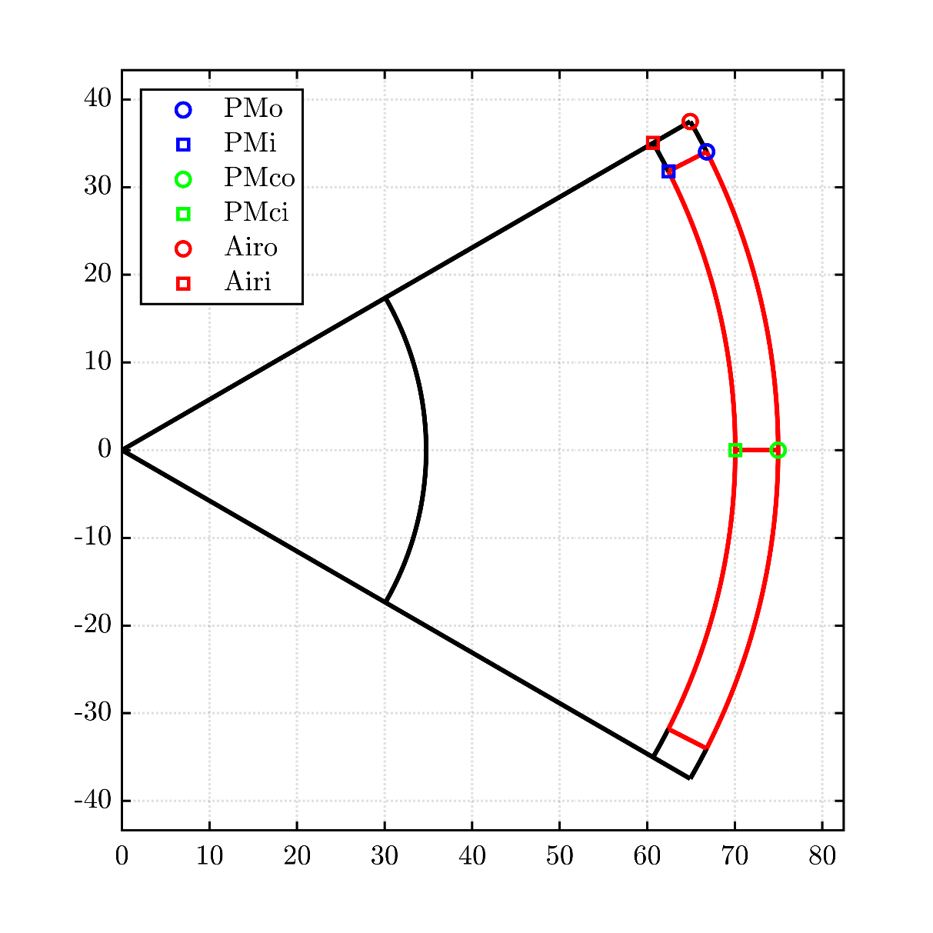
SPM points
Points found in the temp structure, not reported in geo.
About geo:
geo.r = rotor outer radius
geo.hc_pu*geo.g = PM thickness
geo.dalpha_pu*180/pi = PM angle span
geo.Ar = rotor inner radius
geo.hs = sleeve thickness

